Slide 1


Chemical Processes in Interstellar Dust Clouds:
Deuterated Ammonia in Cepheus L1251
Maria Galloway-Sprietsma
Mentor: Dr. Yancy Shirley

Slide 2
Background
If we want to know more about stars, we need to start with where they are born
Stellar formation begins in large molecular clouds
We want to know about the chemical processes happening in these cores
Cepheus L1251 is a star forming region 300 pc away
Image Credit: Lynds Dark Nebula photographed by Lynn Hillborn

Slide 3
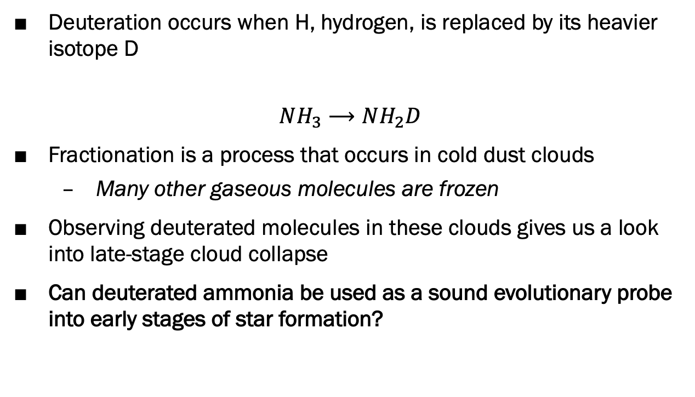
Background
Deuteration occurs when H, hydrogen, is replaced by its heavier isotope D
$$NH_{3}⟶NH_{2}D$$
Fractionation is a process that occurs in cold dust clouds
  Many other gaseous molecules are frozen
Observing deuterated molecules in these clouds gives us a look into late-stage cloud collapse
Can deuterated ammonia be used as a sound evolutionary probe into early stages of star formation?
Image from Dirk Hünniger

Slide 4
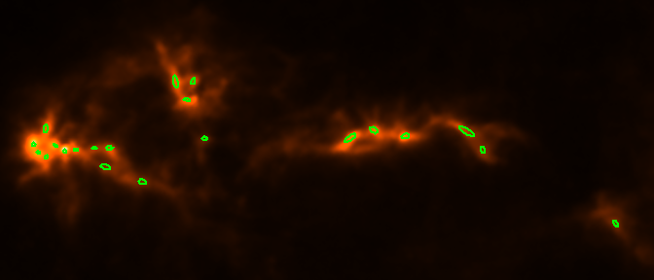
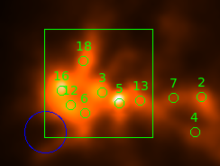
Observations
We observed 22 cores in Cepheus L1251 with the 12M telescope
o-NH₂D brightest at 85.926278 GHz
o-NH₂D was detected in 13 of the 22 cores
Mapping was done on a 6’ by 6’ region

Slide 5
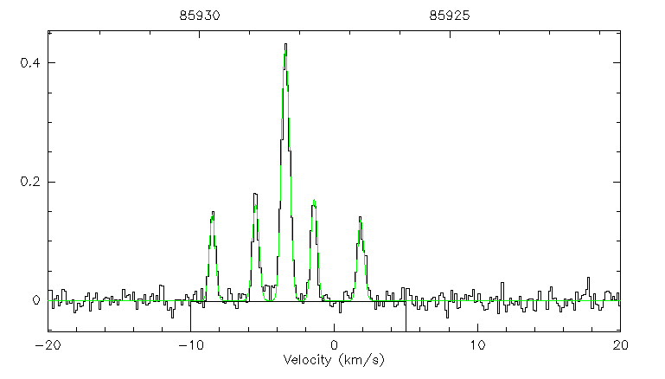
Observations

Slide 6
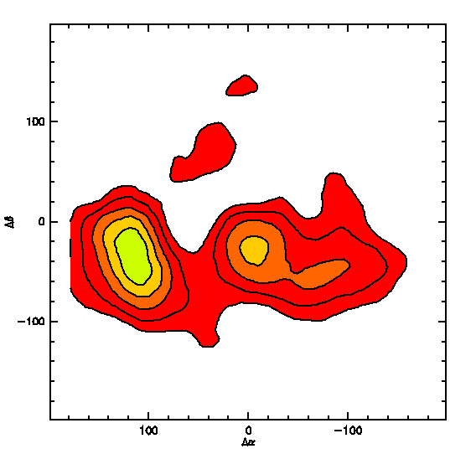
o-NH₂D Mapping Results

Slide 7
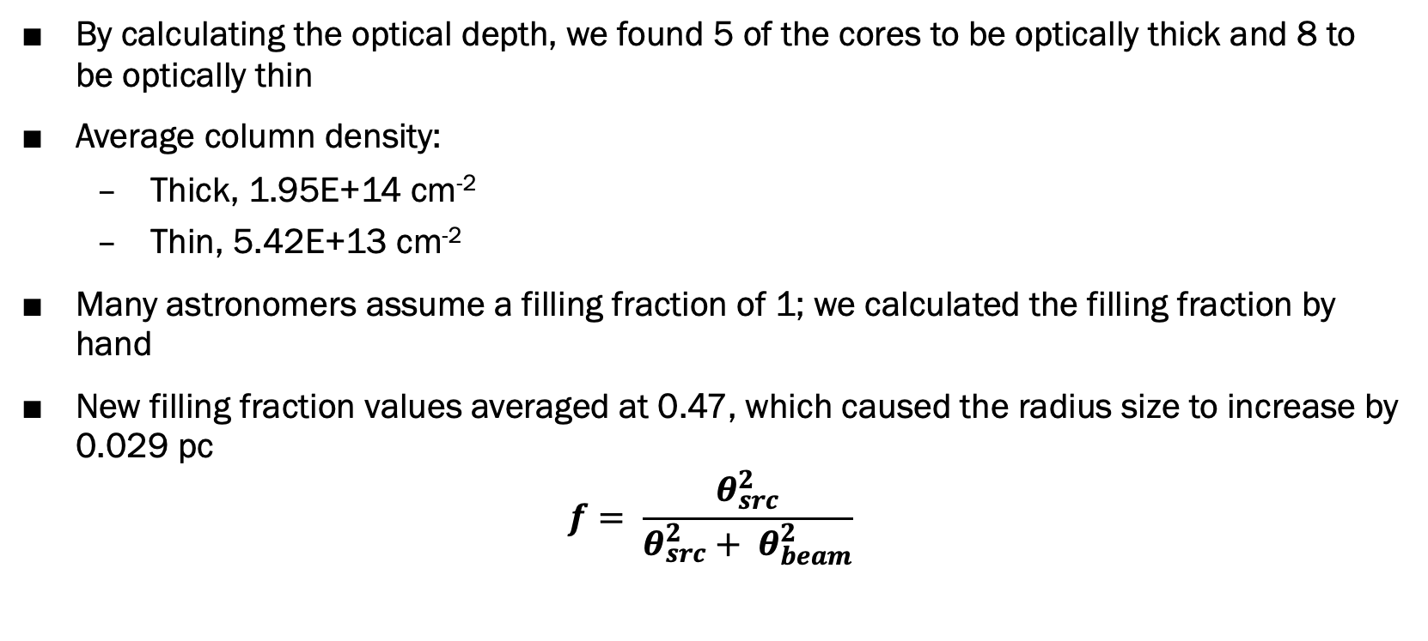
Calculations
By calculating the optical depth, we found 5 of the cores to be optically thick and 8 to be optically thin
Average column density:
  Thick, 1.95E+14 cm⁻²
  Thin, 5.42E+13 cm⁻²
Many astronomers assume a filling fraction of 1; we calculated the filling fraction by hand
New filling fraction values averaged at 0.47, which caused the radius size to increase by 0.029 pc
$$f= \frac{θ_{src}^{2}}{θ_{src}^{2}+ θ_{beam}^{2}}$$

Slide 8
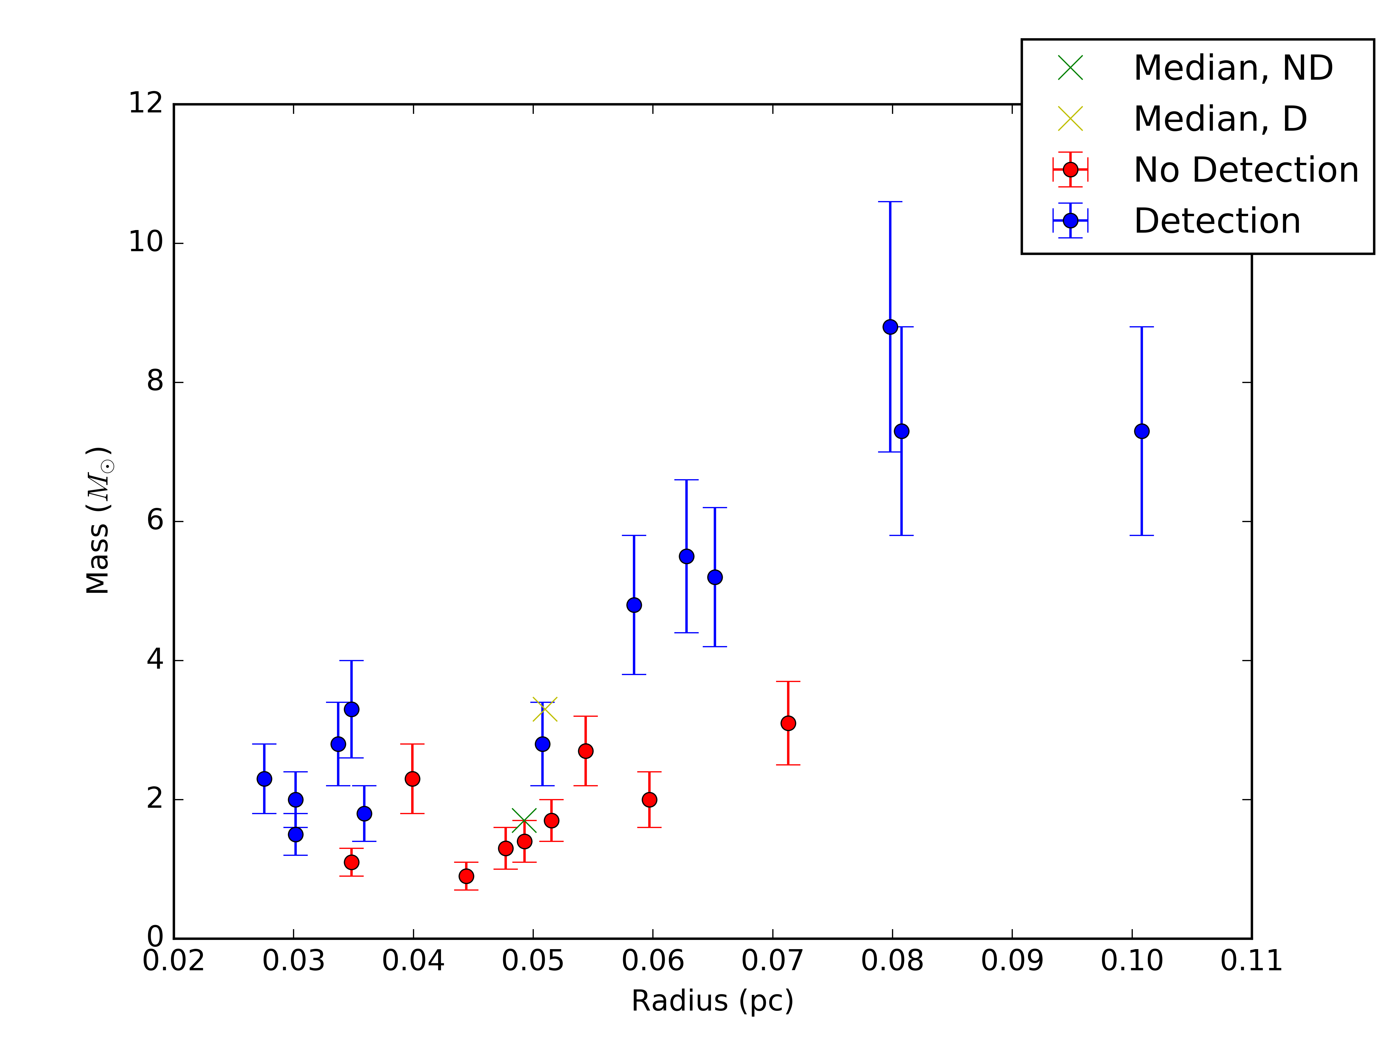
Results
Plot of Radius vs Mass
Significant separation between ND and D cores

Slide 9
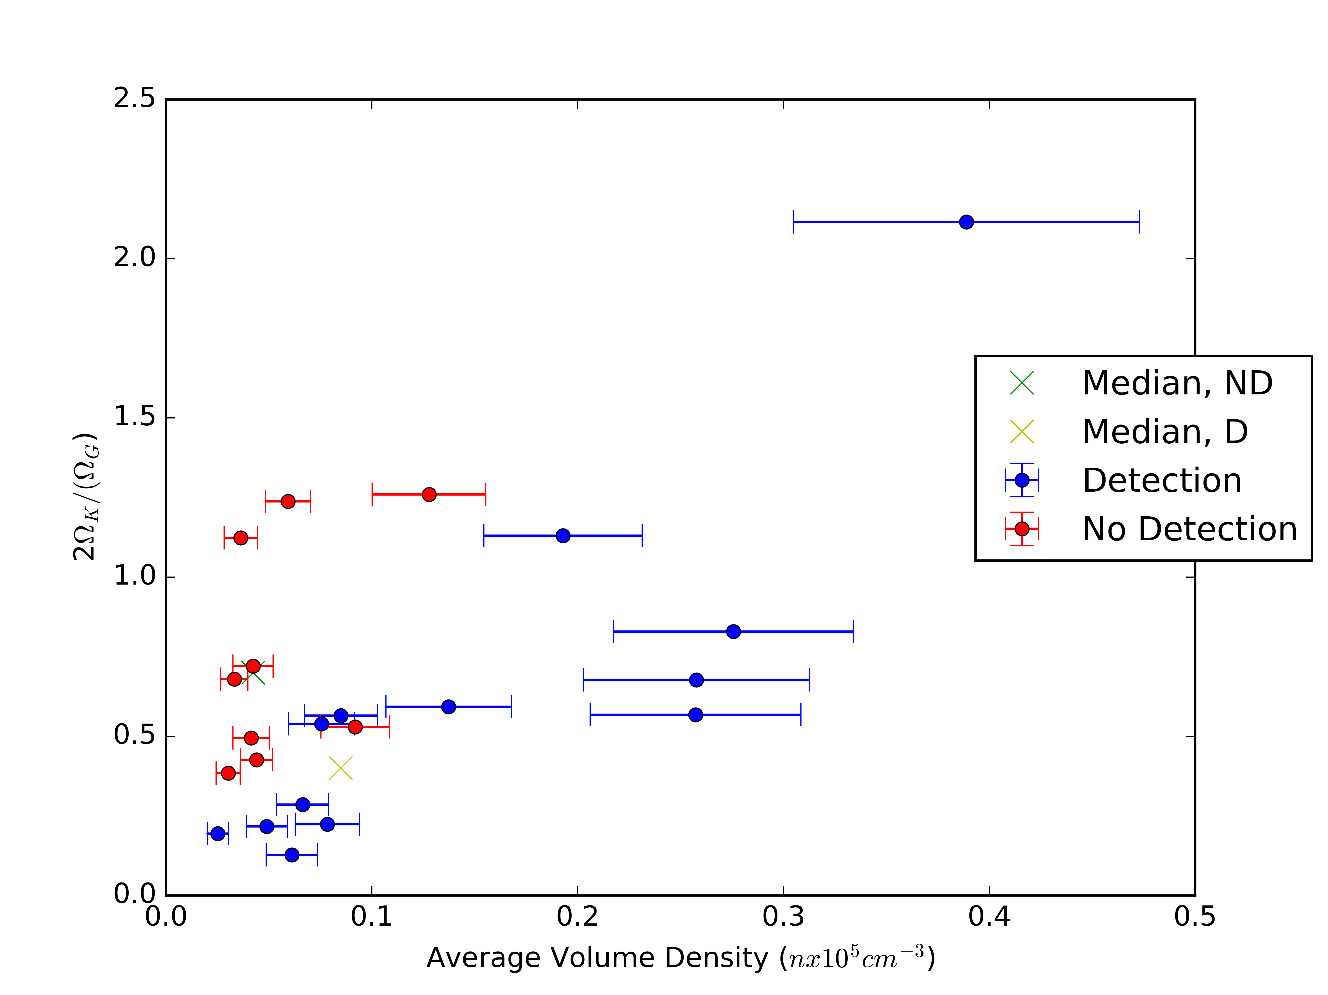
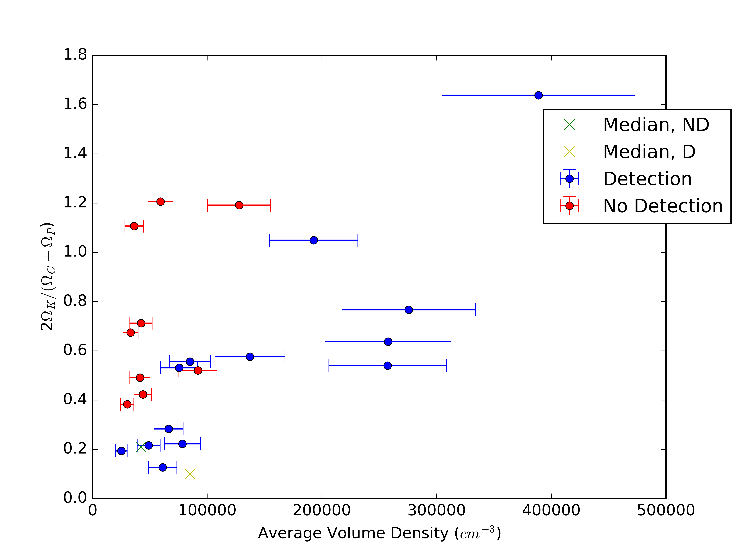
Results
Plot of Virial Parameter vs Average Volume Density
Pressure term is included in bottom plot

Slide 10
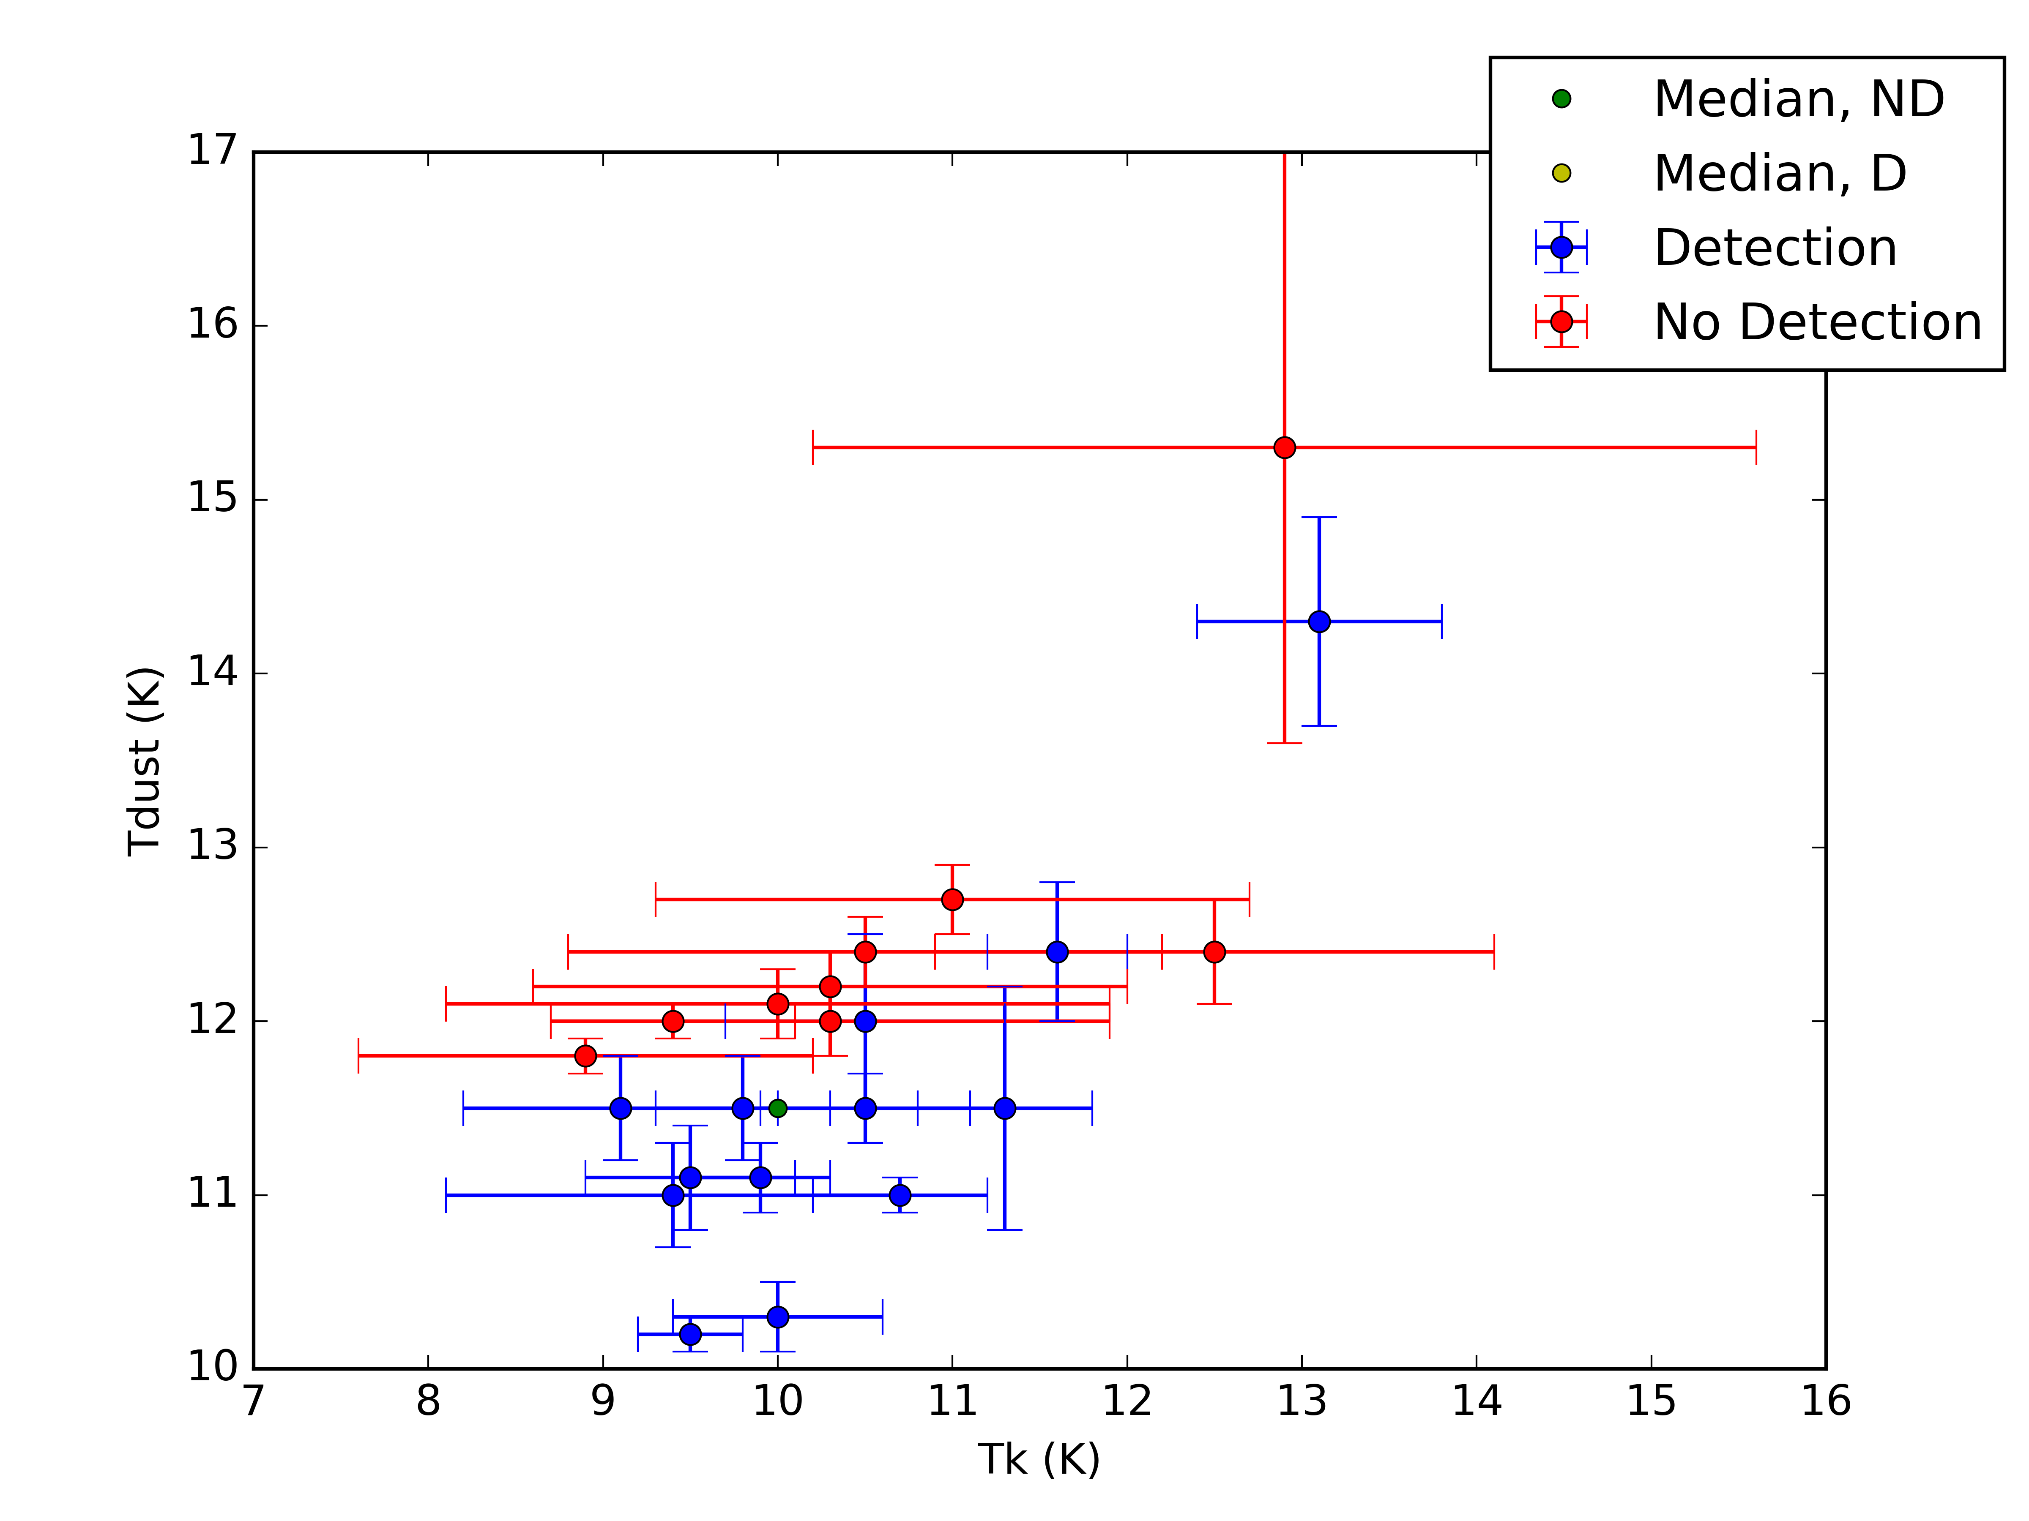
Results
Plot of two different temperatures: Dust Temperature (K) and Gas Kinetic Temperature (K)
Significant separation also visible here

Slide 11
Implications
There is evidence of separation between sources with o-NH₂D detection and those without o-NH₂D detection
Our results also demonstrate differences between the physical properties of optically thin and optically thick sources
These results indicate that the deuteration of ammonia provides an additional evolutionary indicator during the starless and prestellar core phases
Deuteration is an important chemical process that can be used to understand early stellar evolution
We now know more about Cepheus L1251 through the lense of chemical tracer o-NH₂D

Slide 12
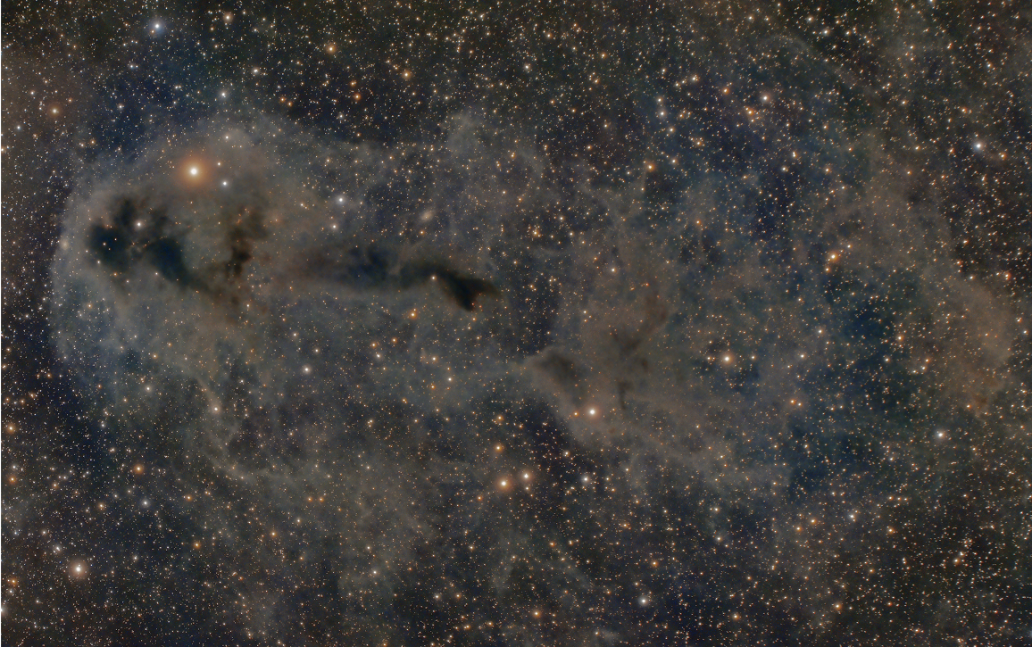
Thank you!
Image Credit: Lynn Hilborn, Lynds Dark Nebula

